Slide 1



Genrative Ai

Slide 2

GenAi Describing itself:
“Generative AI, as a model, learns from vast datasets to replicate and innovate upon human creativity. Through recursive refinement and understanding, I improve my responses by analyzing patterns, crafting coherent outputs, and evolving alongside human interaction.”
Generative AI is a type of artificial intelligence that creates new, original content—such as text, images, audio, or video—by learning patterns from existing data.

Slide 3

GenAI
Model
Architecture
Data
Task
Generative models like Transformers, GANs, and Autoencoders rely on large neural networks with scalable architectures. Transformers use self-attention mechanisms for parallelization. GANs consist of a generator and a discriminator, improving through adversarial training. Autoencoders feature encoder-decoder structures, optimizing for tasks like data compression and anomaly detection.
Generative models require large, diverse datasets to perform well. Transformers thrive on vast amounts of text data, ensuring broad language understanding. GANs rely on image datasets, such as faces or medical images, to generate realistic outputs. Autoencoders need high-quality image or speech data for tasks like denoising and anomaly detection.
Generative models serve a variety of tasks, both general and specialized. Transformers excel in text generation, summarization, and translation. GANs are used for image generation, style transfer, and medical image augmentation. Autoencoders focus on anomaly detection, denoising, and compression, with applications in medical imaging and speech enhancement.

Slide 4
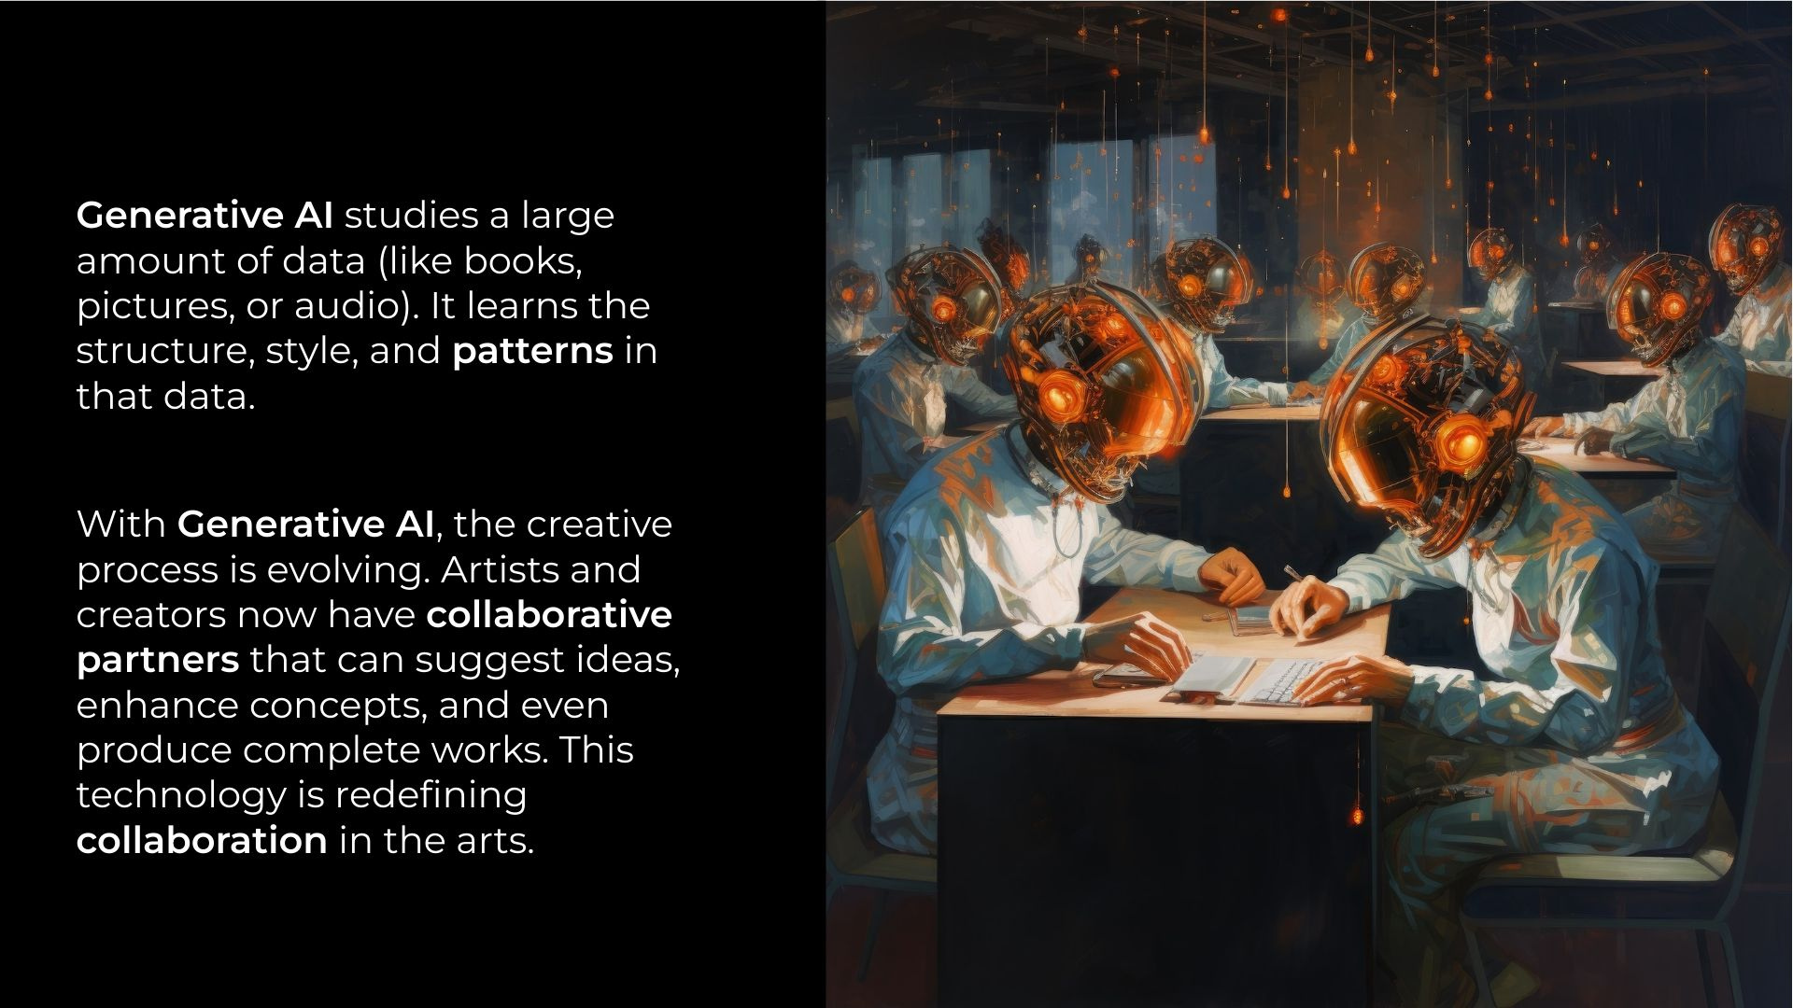

Slide 5
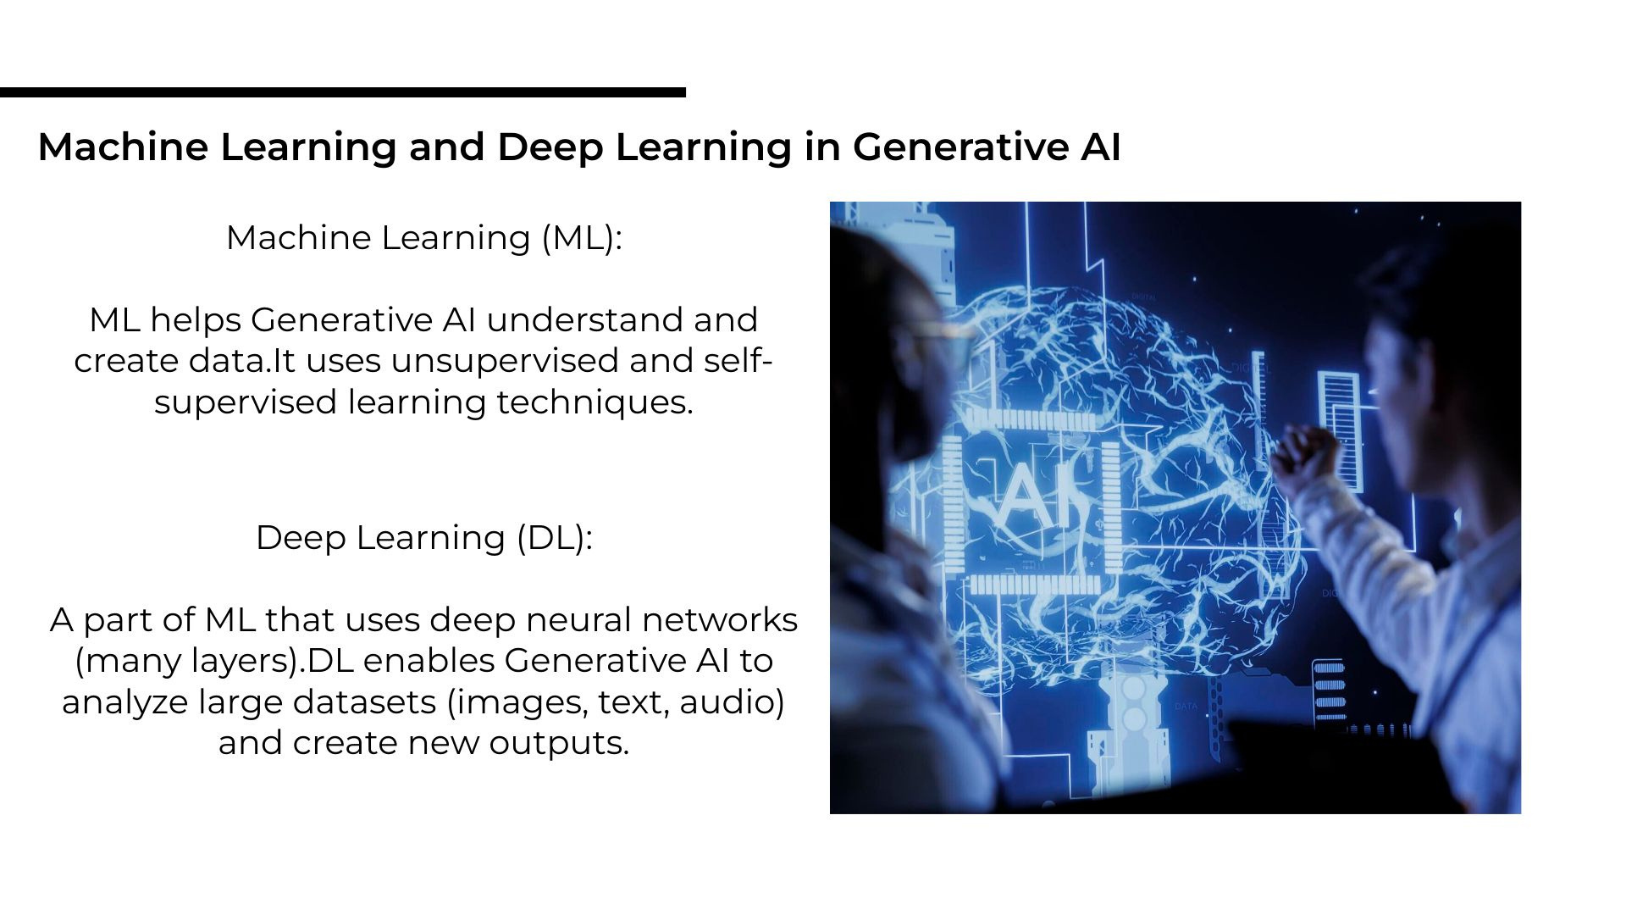

Slide 6
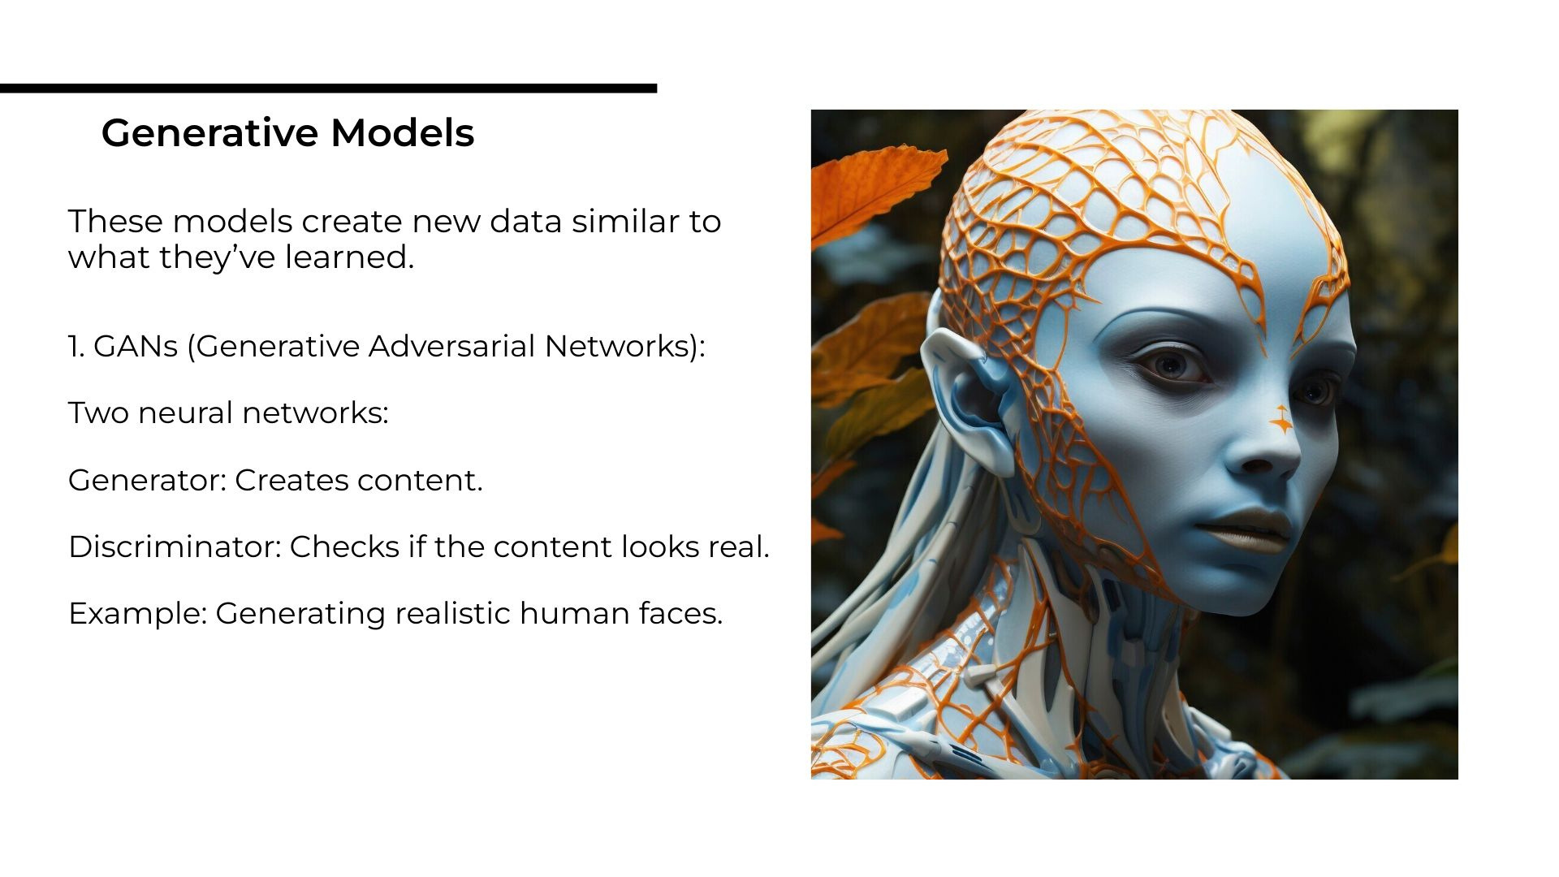

Slide 7
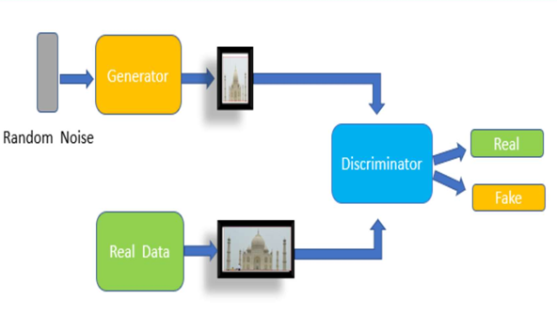
GENRATIVE ADVESARIAL NETWORK
We use GAN model to get realistic and synthesized images of our dataset. GAN is a model which is applied to training set to get images that possessed similar characteristics as of our original data.

Slide 8
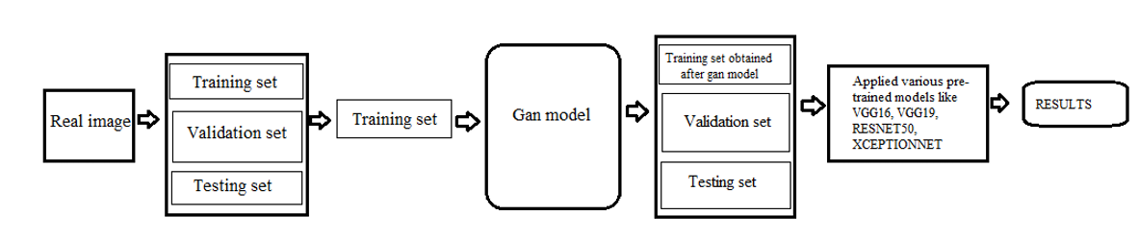
Two neural networks in the GAN operate simultaneously but with opposing functionalities. Two neural networks in the GAN operate simultaneously but with opposing functionalities.
The purpose of the discriminator artificial neural network is to distinguish between the actual images that are presented to it and the images that have been created by random noise given to generator.

Slide 9
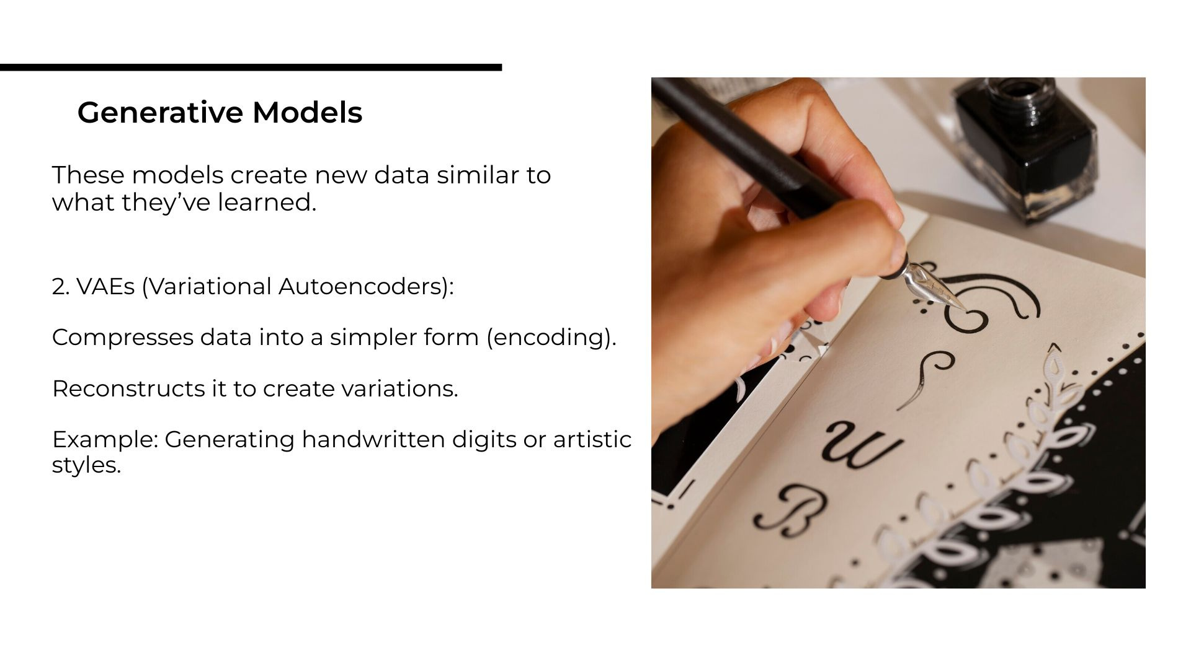

Slide 10
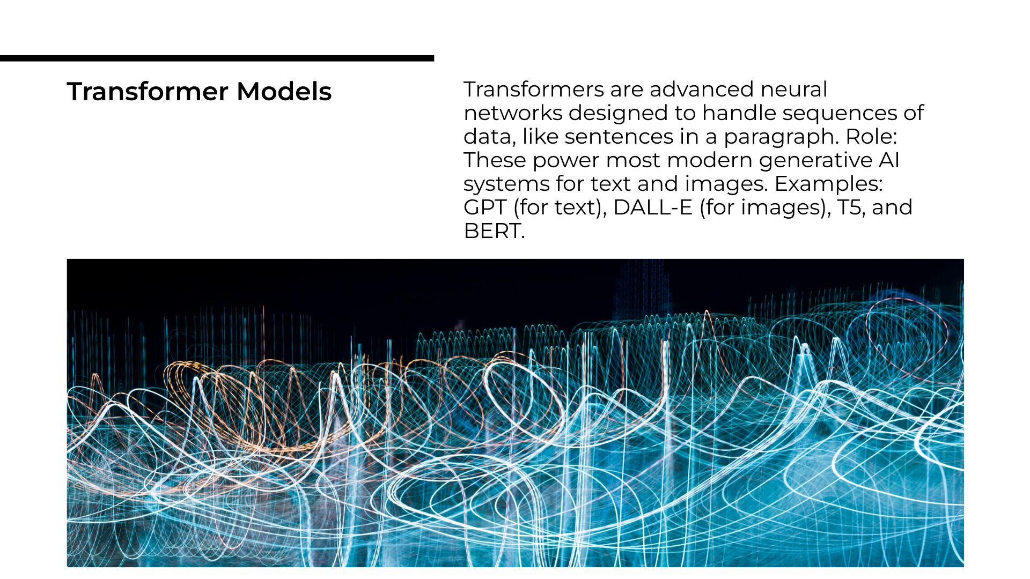

Slide 11
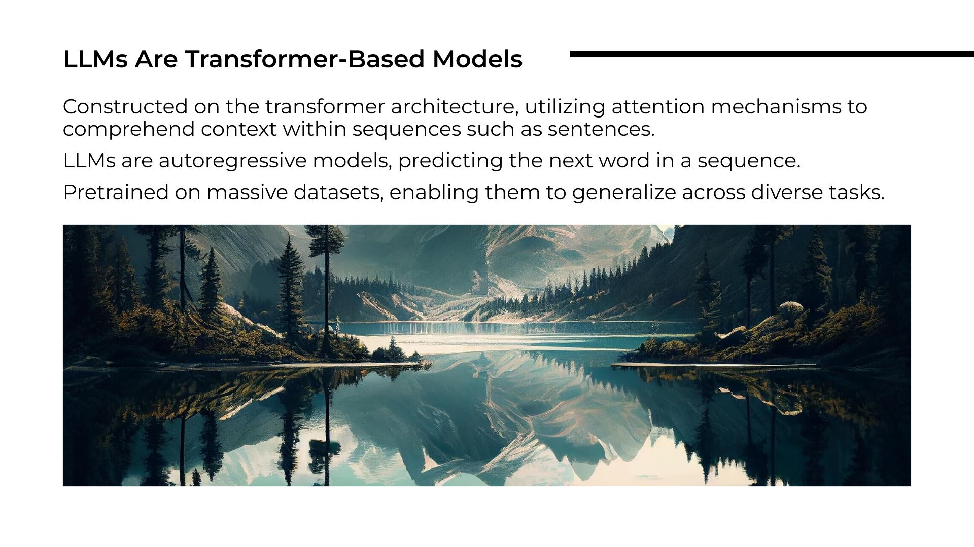

Slide 12
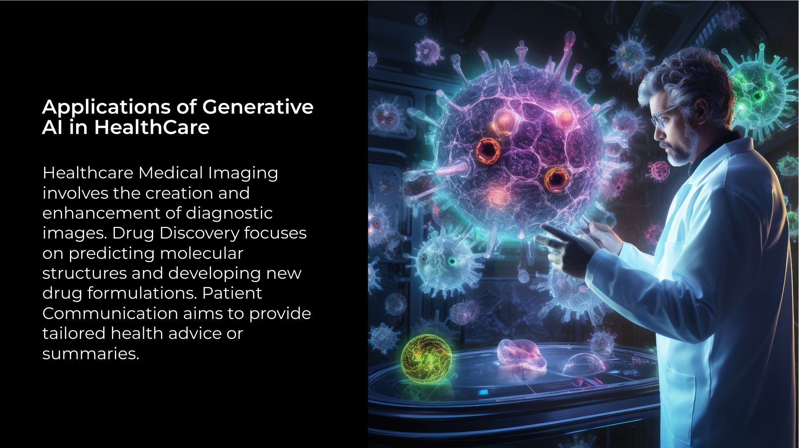

Slide 13
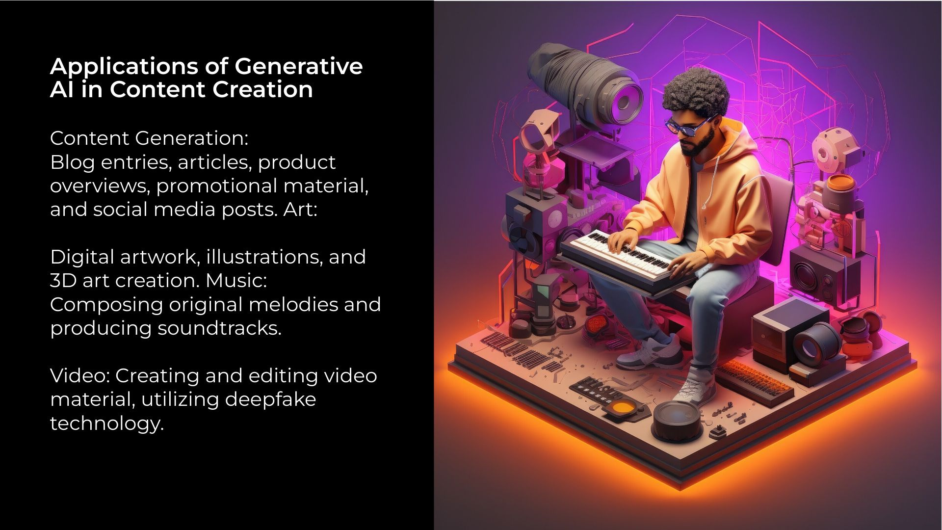

Slide 14
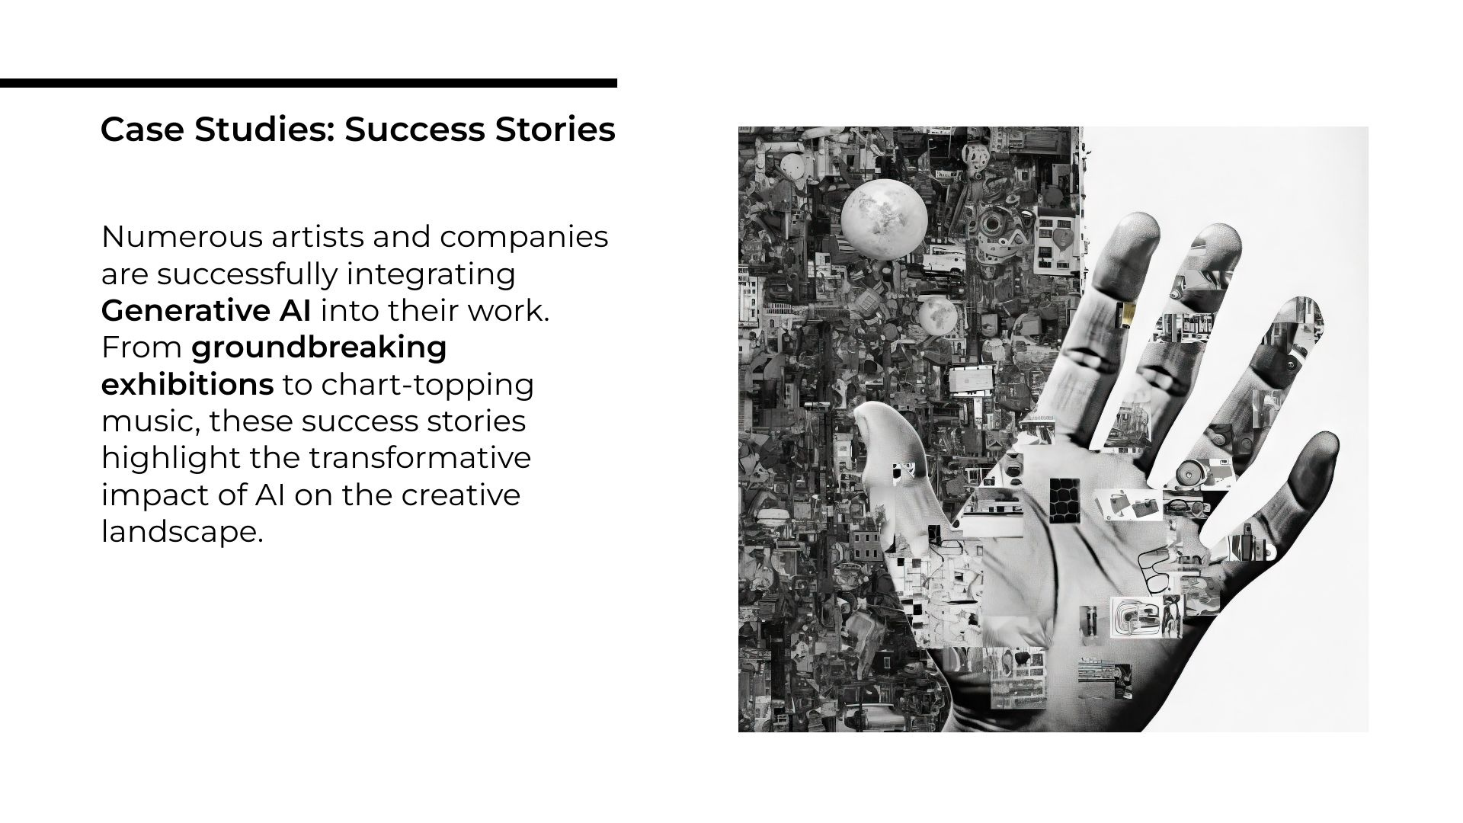

Slide 15
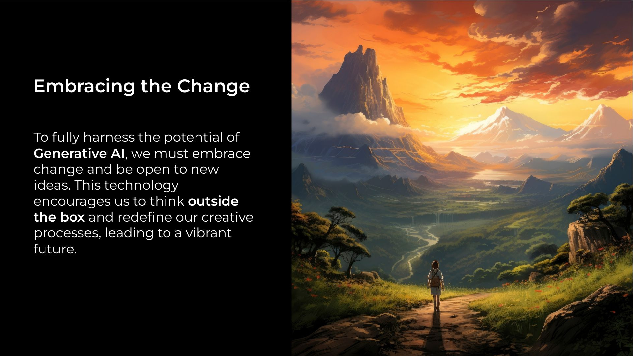

Slide 16
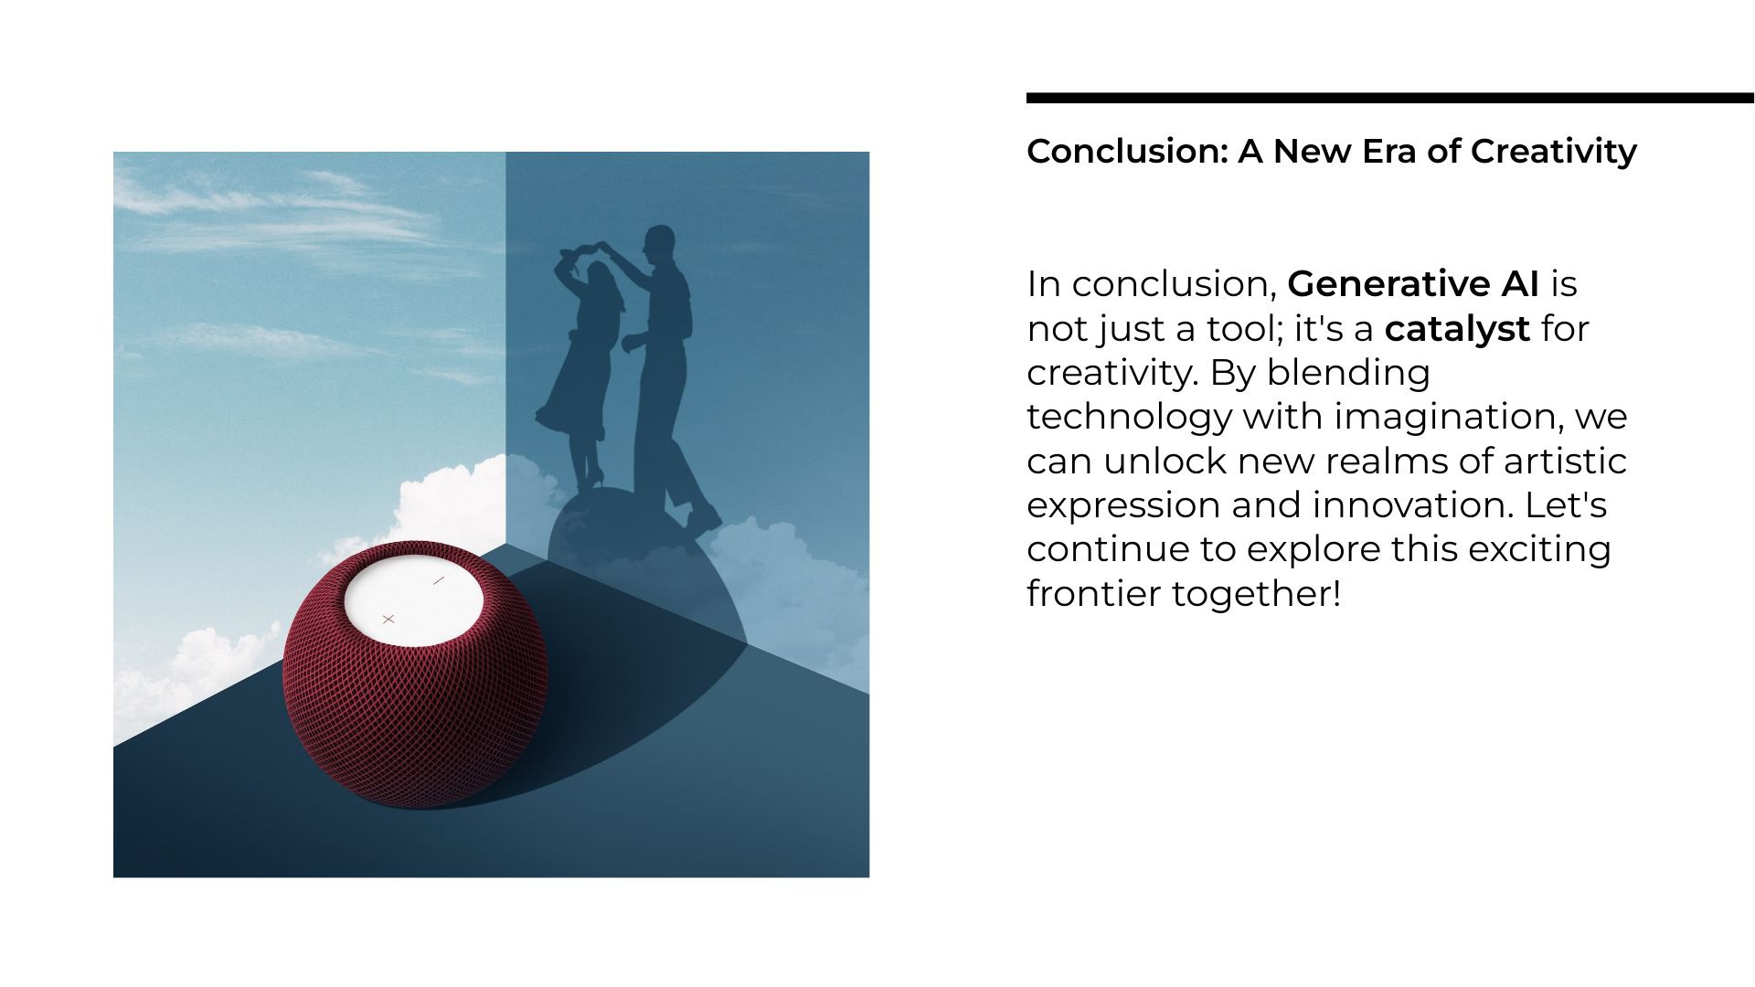

Slide 17


